Slide 1
Scrum Rituals Sprint Retrospect

Slide 2
Week 6 Summary
Roles | Rituals | Artifacts
Scrum Master Product Owner Development Team | Sprint Planning Daily Standup Sprint Demo Sprint Retrospective | Story Product backlog Sprint backlog Scrum board Definition of "done“ Velocity charts Burndown chart Product increment

Slide 3
Week 7 Overview
Roles | Rituals | Artifacts
Scrum Master Product Owner Development Team | Sprint Planning Daily Standup Sprint Demo Sprint Retrospective | Story Product backlog Sprint backlog Scrum board Definition of "done“ Velocity charts Burndown chart Product increment

Slide 4
One- Week Sprint Ritual
(2) Daily Standup
Development
Daily Standup
Development
Daily Standup
Development
(3) Sprint Demo
(4) Sprint Retrospective
(1) Sprint Planning
Development

Slide 5
Sprint Retrospective - Objective
gathers the team together to consider how the sprint that was just completed went for everybody
everyone in the room will be asked what went well, what didn't go well, and what commitment they're willing to make as a group to improve things in the next sprint
goal is to come away with a set of modifications to the process that everybody on the team agrees to try for the upcoming sprint
members of the development team, the scrum master, and the product owner are expected to participate in a sprint retrospective
led by the scrum master

Slide 6
Sprint Retrospective – Time Box
mirrors the amount of time they might spend in the sprint demo
a two-week sprint, devote half a day to the retrospective
good to err on the side of generosity with the time

Slide 7
Sprint Retrospective – Preparation
everybody involved in the scrum should come to the ritual with some thought in mind about what might have happened during the sprint that they want to comment on
scrum master should come an agenda that makes sure both positive and negative feedback is gathered from all participants

Slide 8
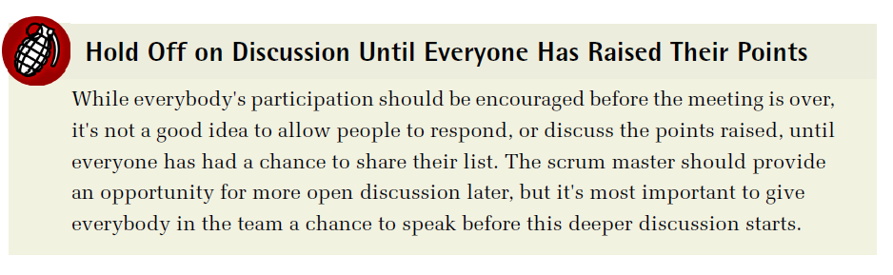
Sprint Retrospective – What Went Well?
scrum master should ask everybody in the room what they thought went well during the past sprint

Slide 9
Sprint Retrospective – What Didn't Go Well?
scrum master should go around the room asking people to report what they didn't think went so well during the sprint
If somebody really doesn't want to speak, or has something to say that they don't want to bring up in front of the group, they should be encouraged to talk about it independently with the scrum master outside of this ritual

Slide 10
Sprint Retrospective – What Should We Do about It?
opened for discussion
everybody on the team to say more about the issues they raised
issues raised by the other teammates
what they think the team should be doing about them

Slide 11
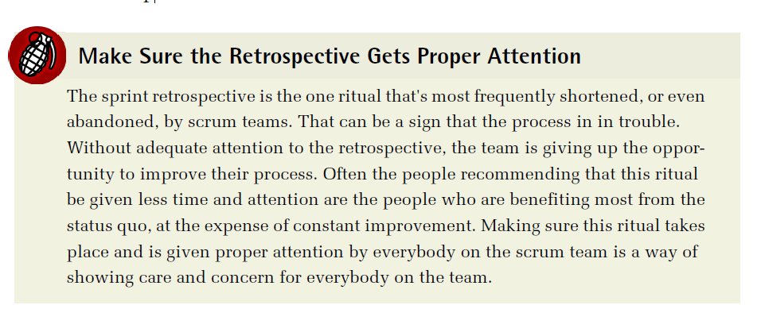

Slide 12
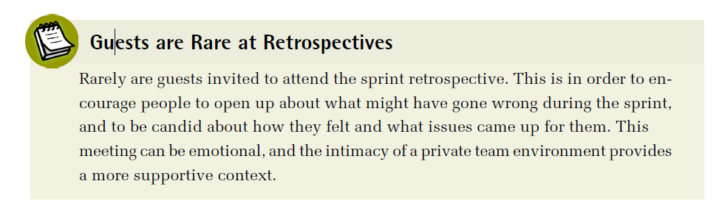

Slide 13
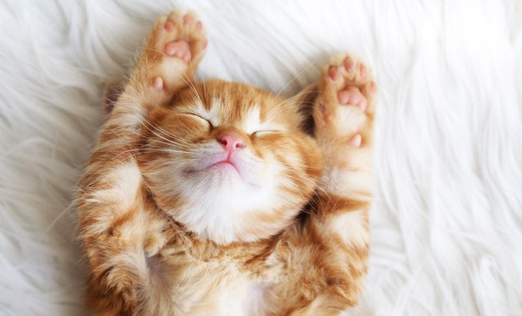
Scrum Example - WithKittens
How Scrum Works

Slide 14
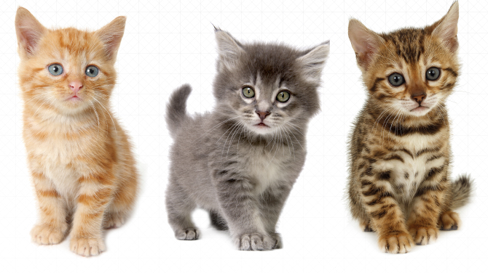
Recap Story Background

Slide 15
Scrum Process Example - WithKittens
WithKittens team
six engineers
image processing specialists
back-end data processing
API management engineers
front-end engineers for both web and mobile interfaces
billing and security experts
one product owner
product management for both desktop and web applications
one scrum master
working together for about three years

Slide 16
Scrum Process Example - WithKittens
Other members
dedicated designer on the design team
a pair of QA engineers
a small team of DevOps engineers
site running and also handle IT issues

Slide 17
Scrum Process Example - WithKittens
unique facets of the service
figuring out the ideal positioning of kittens in pictures
best ways to optimize images for proper delivery

Slide 18
Why Just Kittens?
founder and CEO of the company has a long history of working with cat rescue societies
idea for the service began as something to support one local nonprofit organization, and grew quickly as other nonprofits
users decided they also wanted to be able to add kittens to their pictures

Slide 19
Scrum Process Example - WithKittens
produce both a website and a mobile application designed to add pictures of kittens to any image uploaded by their clients
free tier customers (most)
adding kittens to their own social media images and sharing them
paying customers (some)
for the privilege of knowing only the very best kittens will be added to their images consistently and reliably
great deal more control over the quality and content than free users get
high-end social media users
people who want more control over the way their kittens are presented in their pictures
growing business clientele, including companies who use theWithKittens service to add appeal
important to keep paying clients happy

Slide 20
Problem at Kitten Haven
the company's focus on kitten-only content has never been a serious issue before
but recently, the company's largest clients, a multinational marketing conglomerate were planning to switch contracts to a competitor. They puppy images

Slide 21
CEO & Product Owner
Meeting between CEO and product owner
value of adapting to changing market expectations
the appropriateness of adding a service that conflicts with the historical intent of the company
conflict with company name
decided to work on puppy-friendly features
keeping in mind are the overhead of maintaining an entirely independent service versus the cost of developing and supporting an integrated service
scheduled to work on next

Slide 22
So far….
Team completed Sprint Planning
Already prepared
Scrum Board
Product Backlog
Stories
Sprint Backlog
Team ran Daily Standup for Sprint 11
Team completed Sprint 11 (one week scrum sprint)
Team completed Sprint Demo
Next step -> Sprint Retrospect

Slide 23
Sprint Retrospective
After demo is completed and the sprint is closed
get people talking about
what they think went well during the last sprint
what they could have done better
what changes they think they should make to the process going forward.

Slide 24
Sprint Retrospective
junior engineer: One thing I think went really well was having the opportunity to follow that big story from start to finish. It gave me a great chance to see how our architecture works from top to bottom.
Engineer 6: You did a really good job on it. I learned some things about our own architecture that I didn't know, too. There's some really messy stuff in there
Engineer 1: Yeah. That's one of the things I think didn't go so well. I really think we should have had the chance to do the refactoring before trying to build this all out

Slide 25
Sprint Retrospective
Engineer 2: I agree. But now at least we have a sense of where some of the mess is, so we know what to focus on first.
Engineer 3: It would have been easier if I had just been able to dive in and fix that stuff first. I already knew where most of it was, and it still bothers me that we did it backwards
Engineer 2: At least now you're not the only one who knows
Engineer 3: Yeah, but it sounds as if we're not going to get a chance to do the refactoring this sprint, either
Engineer 4: That's how it sounded to me too. They're going to stick in the stories to get the design changes for the beta done first

Slide 26
Sprint Retrospective
scrum master: We probably are going to have some design stories to fix the visuals for the beta. But the product owner did agree to give us time for the refactor as a top priority if we finished the story, and we did. I'll follow up on that before the planning meeting to make sure
Engineer 3: Well one thing is that I want to go through those new designs with a fine-toothed comb and make sure they're really final before we estimate them.
scrum master: Should we make that another goal for the next sprint?

Slide 27
Sprint Retrospective
At the end of the retrospective
short list of improvements
a couple of tasks for the scrum master to follow up on with the product owner
priority for the next sprint
refactoring code

Slide 28
The End

Slide 29
Week 7 Summary
Roles | Rituals | Artifacts
Scrum Master Product Owner Development Team | Sprint Planning Daily Standup Sprint Demo Sprint Retrospective | Story Product backlog Sprint backlog Scrum board Definition of "done“ Velocity charts Burndown chart Product increment

